Slide 1

National University of Computer and Emerging Sciences,
Islamabad, Pakistan
Architectures of Convolutional Neural Networks
CS-4045: Deep Learning

Slide 2
Goals
Today’s Lecture
ConvNets vs. Traditional Computer Vision
ConvNet Architectures
LeNet
AlexNet
VGG
The Inception Family
V1, V2, V3, V4, Inception-ResNet, Xception
Resent
DenseNet

Slide 3
ConvNets vs. Traditional for Computer Vision
Image classification is the task of classifying a given image into one of the pre-defined categories.
Traditional pipeline for image classification involves two modules:
Feature extraction
Classification.

Slide 4
Traditional Classification Pipeline
Feature extraction involves extracting a higher level of information from raw pixel values that can capture the distinction among the categories involved.
This feature extraction is done in an unsupervised manner wherein the classes of the image have nothing to do with information extracted from pixels.
Some of the traditional and widely used features are HOG, SIFT, LBP etc.
After the feature is extracted, a classification module is trained with the images and their associated labels. A few examples of this module are SVM, Logistic Regression, Random Forest, decision trees etc.

Slide 5
Traditional Classification Pipeline
The problem with this pipeline is that feature extraction cannot be tweaked according to the classes and images.
Features lack the representation required to distinguish the categories
Accuracy of the classification model suffers a lot, irrespective of the type of classification strategy employed.
A common theme among the state of the art following the traditional pipeline has been, to pick multiple feature extractors and club them inventively to get a better feature.
But this involves too many heuristics as well as manual labor to tweak parameters according to the domain to reach a decent level of accuracy.

Slide 6
Traditional Classification Pipeline
Another problem with this method is that it is completely different from how we humans learn to recognize things.
Just after birth, a child is incapable of perceiving his surroundings, but as he progresses and processes data, he learns to identify things.
This is the philosophy behind deep learning, wherein no hard-coded feature extractor is built in.
It combines the extraction and classification modules into one integrated system and it learns to extract, by discriminating representations from the images and classify them based on supervised data.

Slide 7
Automatic Feature Learning
One such system is multilayer perceptrons aka neural networks which are multiple layers of neurons densely connected to each other.
A deep vanilla neural network has such a large number of parameters involved that it is impossible to train such a system without overfitting the model due to the lack of a sufficient number of training examples.
But with Convolutional Neural Networks(ConvNets), the task of training the whole network from the scratch can be carried out using a large dataset like ImageNet.

Slide 8
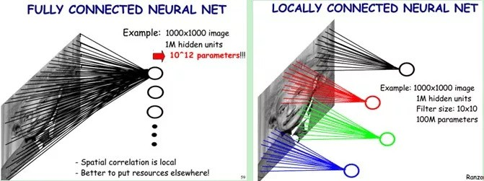
Automatic Feature Learning
The reason behind this is, sharing of parameters between the neurons and sparse connections in convolutional layers.
In the convolution operation, the neurons in one layer are only locally connected to the input neurons and the set of parameters are shared across the 2-D feature map.

Slide 9
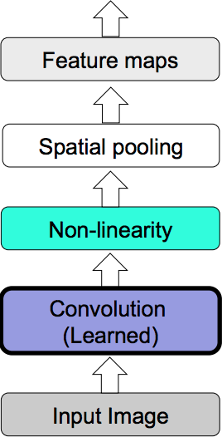
ConvNet Architectures
Almost all CNN architectures follow the same general design principles of successively applying convolutional layers to the input.
Periodically downsampling the spatial dimensions while increasing the number of feature maps.

Slide 10
ConvNet Architectures
While the classic network architectures were comprised simply of stacked convolutional layers, modern architectures explore new and innovative ways for constructing convolutional layers in a way which allows for more efficient learning.
Almost all of these architectures are based on a repeatable unit which is used throughout the network.

Slide 11
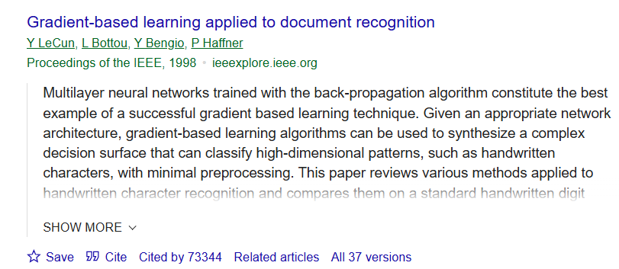
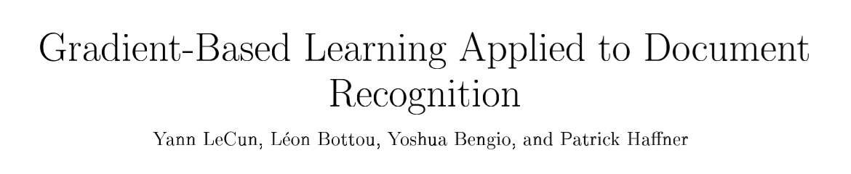
LetNet-1998

Slide 12
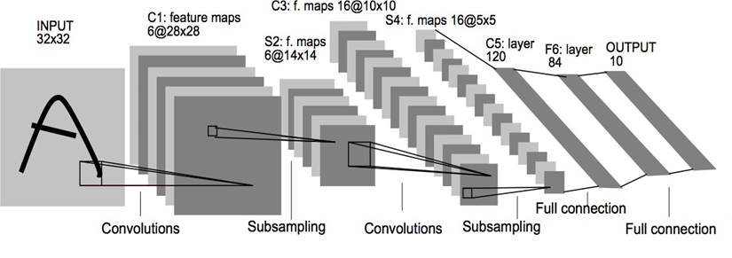
LeNet-5
Yann Lecun's LeNet-5 model was developed in 1998 to identify handwritten digits for zip code recognition in the postal service.
This pioneering model largely introduced the convolutional neural network as we know it today.

Slide 13
LeNet-5
Convolutional layers use a subset of the previous layer's channels for each filter to reduce computation and force a break of symmetry in the network.
The subsampling layers use a form of average pooling.
Parameters: 60,000
Paper: Gradient-based learning applied to document recognition

Slide 14
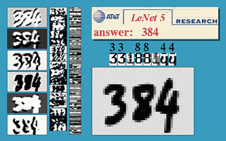
LeNet-5: Reading a Check

Slide 15
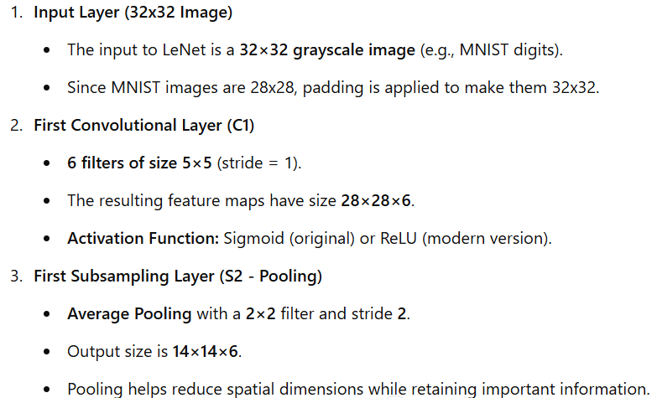
Architecture of LeNet-5

Slide 16
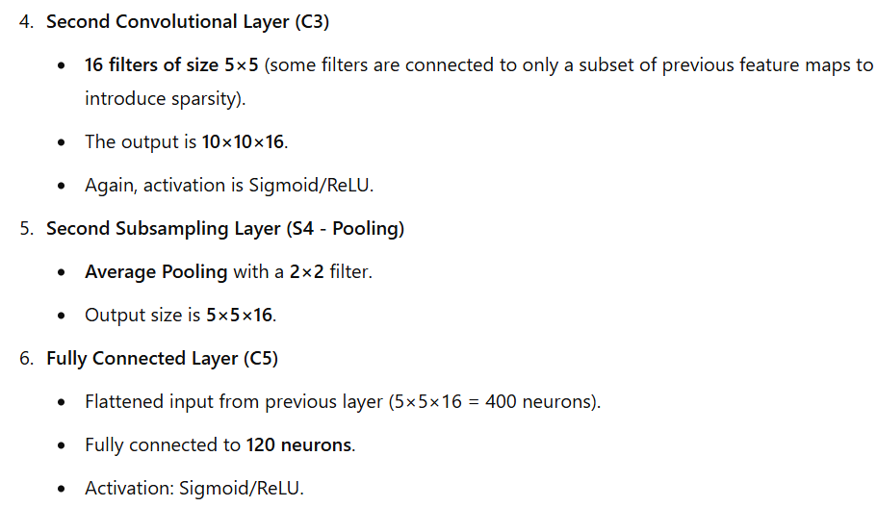
Architecture of LeNet-5

Slide 17
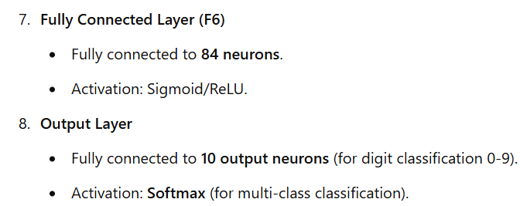
Architecture of LeNet-5

Slide 18
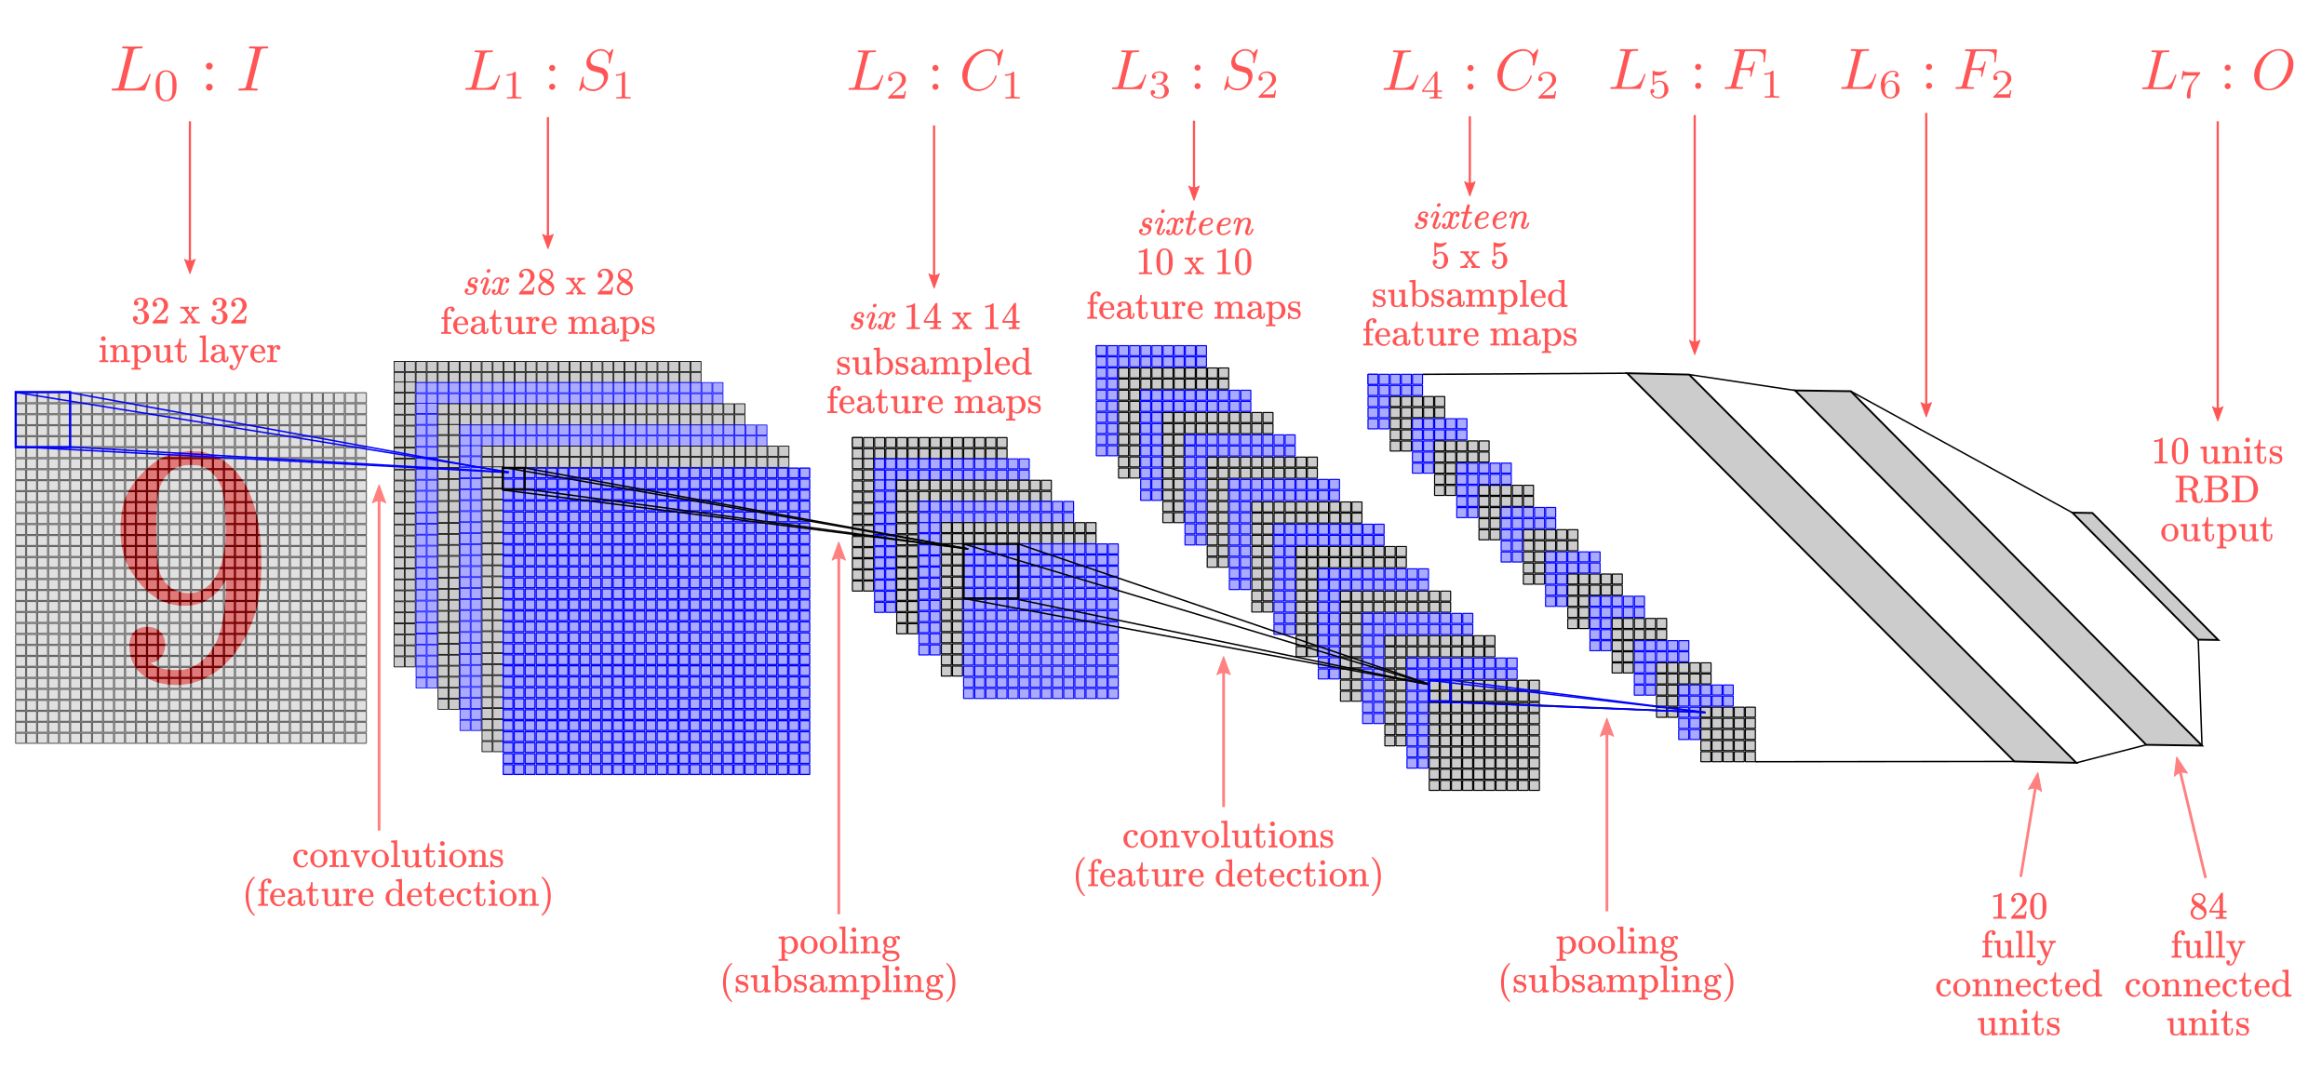
Architecture of LeNet-5

Slide 19
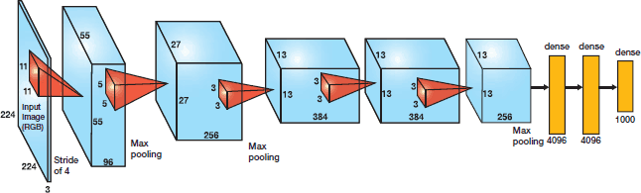
AlexNet
AlexNet was developed by Alex Krizhevsky et al. in 2012 to compete in the ImageNet competition.
The general architecture is quite similar to LeNet-5, although this model is considerably larger.

Slide 20
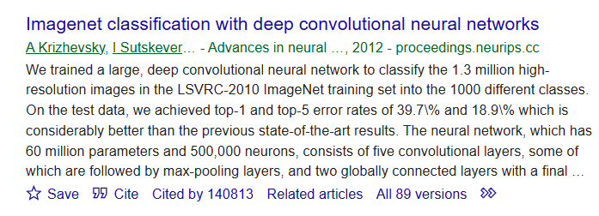
AlexNet
Download Paper

Slide 21
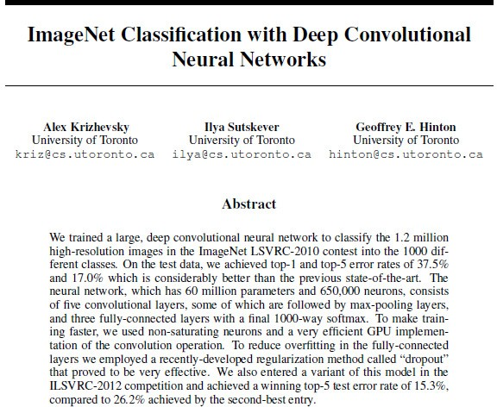
AlexNet

Slide 22
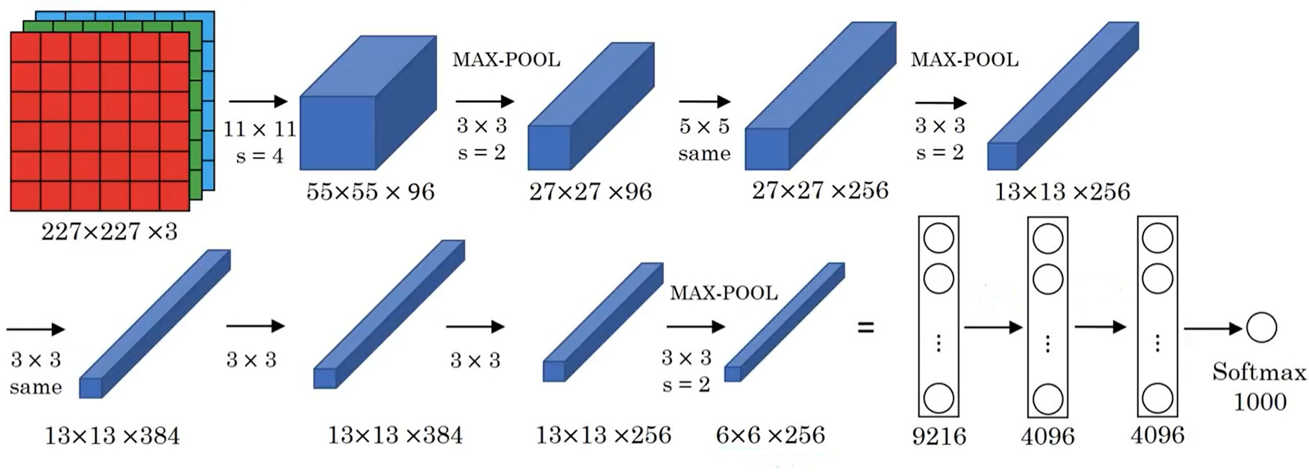
AlexNet
Similarities with LeNet but much bigger

Slide 23
AlexNet
It starts with 227 x 227 x 3 images and the next convolution layer applies 96 of 11 x 11 filter with stride of 4.
The output volume reduce its dimension by 55 x 55.
Next layer is a pooling layer which applies max pool by 3 x 3 filter along with stride 2.
It goes on and finally reaches FC layer with 9216 parameter and the next two FC layers with 4096 node each.
At the end, it uses Softmax function with 1000 output classes.
Parameters: 60 Million.

Slide 24
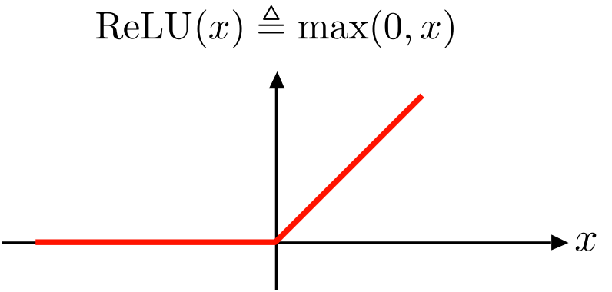
AlexNet
It uses ReLU activation function instead Sigmoid or tanh functions (In LeNet).
The advantage of the ReLu over sigmoid is that it trains much faster than the latter because the derivative of sigmoid becomes very small in the saturating region and therefore the updates to the weights almost vanish
It speed by more than 5 times faster with same accuracy
Dying ReLU problem: If a neuron is inactive (𝑥≤0x≤0), its gradient becomes zero

Slide 25
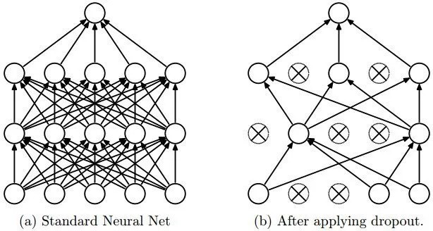
AlexNet
Another problem that this architecture solved was reducing the over-fitting by using a Dropout layer after every FC layer.
Dropout layer has a probability,(p), associated with it and is applied at every neuron of the response map separately. It randomly switches off the activation with the probability p

Slide 26
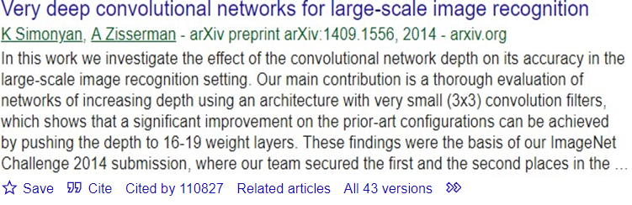
VGG
VGG

Slide 27
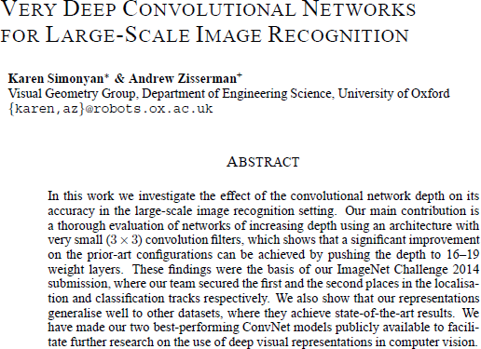
VGG

Slide 28
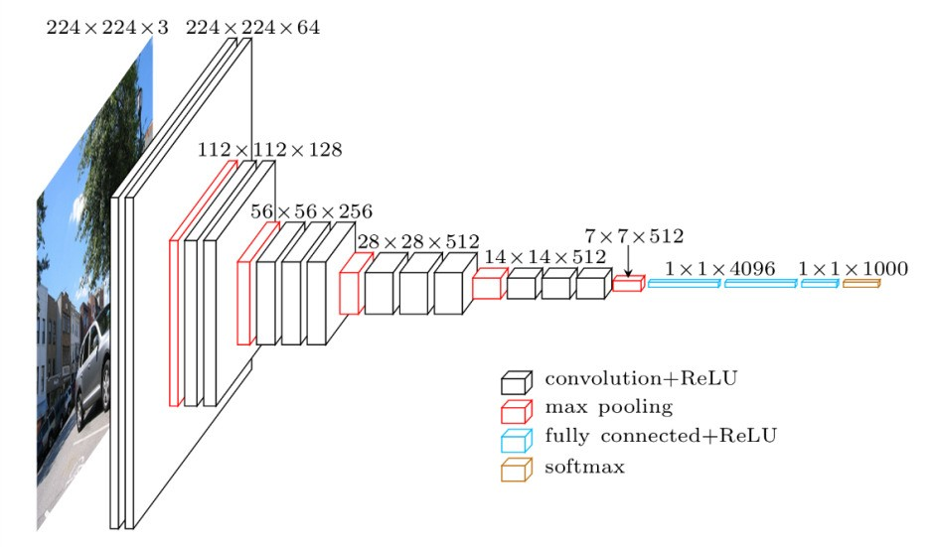
VGG
This architecture is from VGG group, Oxford.
The VGG network, introduced in 2014, offers a deeper yet simpler variant of the convolutional structures.
At the time of its introduction, this model was considered to be very deep.

Slide 29
VGG
It makes the improvement over AlexNet by replacing large kernel-sized filters (11 and 5 in the first and second convolutional layer, respectively) with multiple 3X3 kernel- sized filters one after another.
With a given receptive field (the effective area size of input image on which output depends), multiple stacked smaller size kernel is better than the one with a larger size kernel.
Multiple non-linear layers increases the depth of the network which enables it to learn more complex features, and that too at a lower cost.
It always uses 3 x 3 filters with stride of 1 in convolution layer and uses SAME padding in pooling layers 2 x 2 with stride of 2 – Simplified architecture

Slide 30
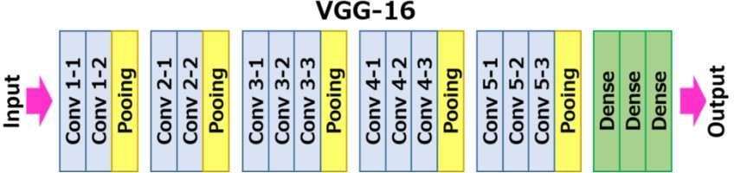
VGG
VGGParameters: 138 million

Slide 31
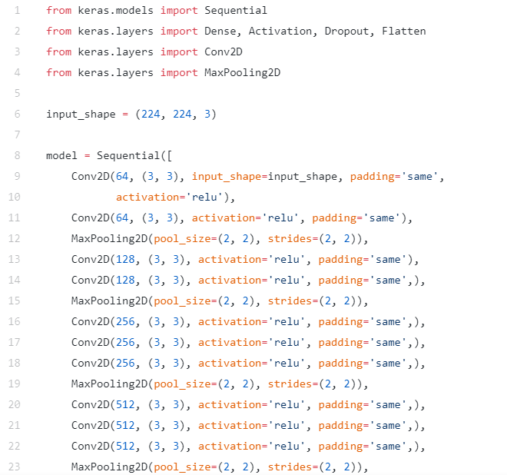
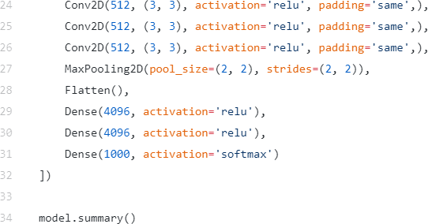
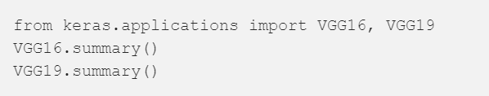
VGG
VGG

Slide 32
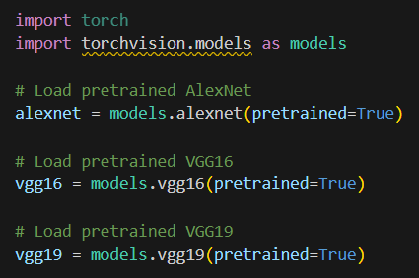
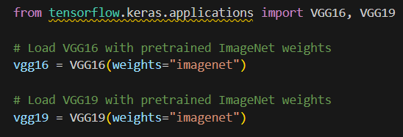
Pre-Trained Models

Slide 33
What is Transfer Learning?
Transfer learning is a machine learning technique where a model trained on a large dataset (e.g., ImageNet) is reused and fine-tuned on a smaller, specific dataset.
Avoids Training from Scratch – Training deep models like VGG or AlexNet from scratch on small datasets is inefficient.
Reduces Training Time – Since the model already knows basic patterns (edges, textures, shapes), only the last layers need to be trained.

Slide 34
What is Transfer Learning?
Prevents Overfitting – With fewer data points, training a deep network from scratch can lead to overfitting.
Transfer learning mitigates this.
Improves Accuracy – Pretrained models on large datasets generalize better and learn more effectively on smaller datasets.

Slide 35
When to Use Transfer Learning?
Recommended Scenarios:
Small dataset (few thousand images)
Similar dataset to ImageNet (e.g., Cars, Animals, Fruits)
Not Recommended
Completely different dataset (e.g., Medical Images, X-rays)
Large dataset (>1M images)

Slide 36
How to Use Transfer Learning?
There are two main approaches:
A. Feature Extraction (Frozen Layers)
Keep pretrained convolutional layers frozen (don’t update weights).
Replace the fully connected layers and train only them.
Used when dataset is small but similar to the original dataset.
B. Fine-tuning (Unfreeze Some Layers)
Unfreeze some deep convolutional layers and train them along with the new classifier.
Used when the dataset is large or very different from ImageNet

Slide 37
Using VGG16 for a Custom Dataset
Load VGG16 pretrained on ImageNet (1000 classes).
Remove the last layers (fully connected layers).
Add custom layers for our dataset (e.g., 10 classes).
Train on a small dataset.

Slide 38
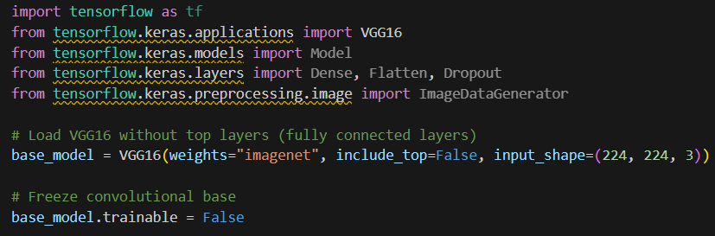
Step 1: Load Pretrained VGG16 Model

Slide 39
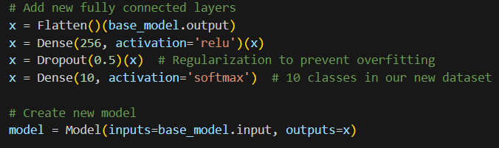
Step 2: Add Custom Layers

Slide 40
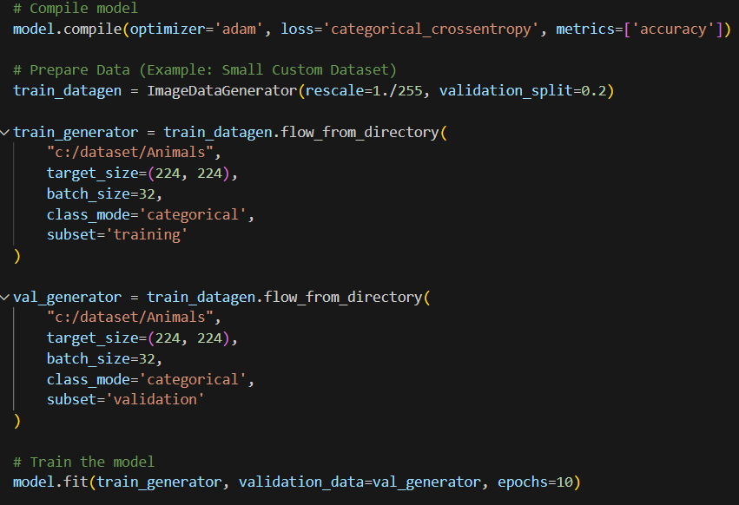
Step 3: Compile and Train
If we set class_mode='sparse', labels are assigned as integers
Cat → 0
Dog → 1
Elephant → 2

Slide 41
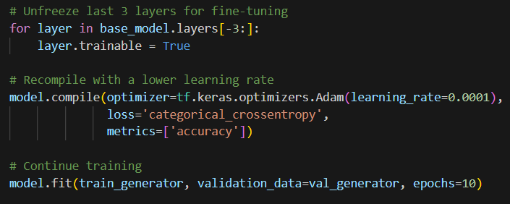
Fine-Tuning

Slide 42
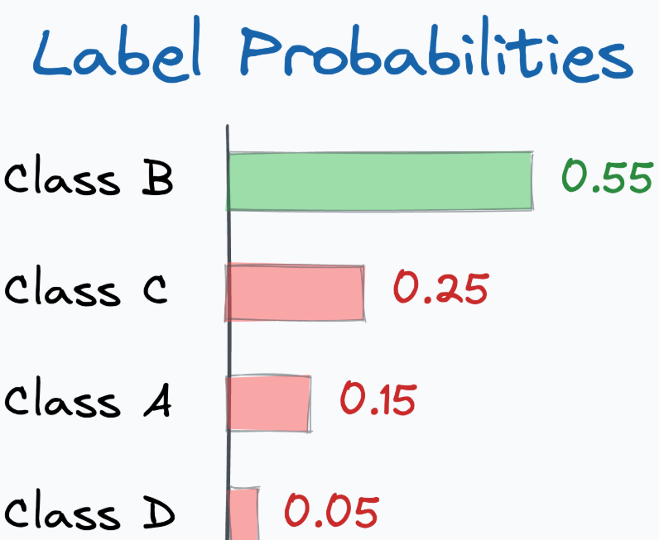
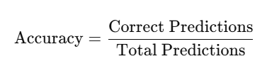
Evaluation Metrics
Accuracy is a common metric for classification models.
Top-K Categorical Accuracy (for large class datasets, like ImageNet):
Checks if the correct label is in the top K predictions.

Slide 43
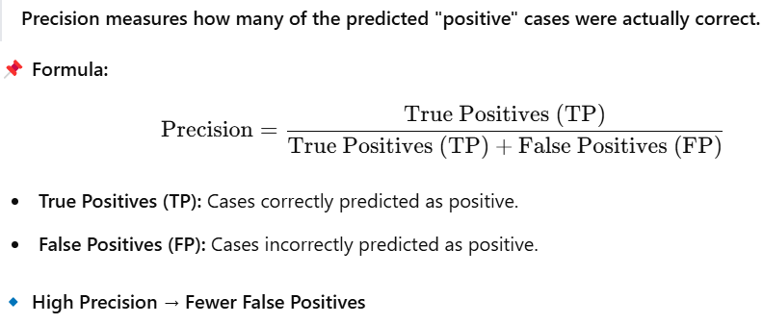
Evaluation Metrics
Precision and Recall (for imbalanced data):

Slide 44
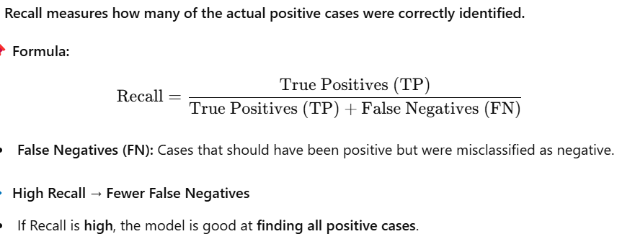
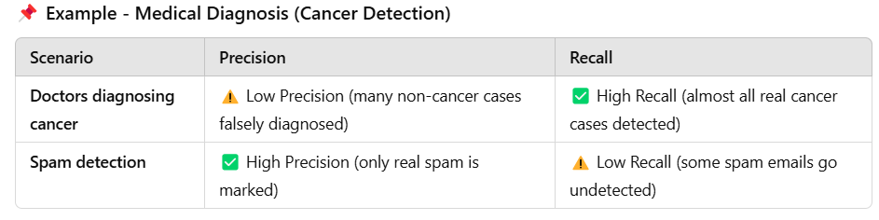
Evaluation Metrics

Slide 45
Thank You ☺

